Slide 1
Agenda – 9/23
Welcome
Homework # 2 and Quiz # 2 Questions
Lecture – Network Management (Chap 4)
Lecture – Wired Ethernet LANs (Chap 5)
Next Week – Homework # 3 and # 4 Due, Quiz # 3

Slide 2

Network Management
Chapter 4
Panko and Panko: Business Data Networks and Security, 9th edition
Copyright Pearson 2013

Slide 3
Perspective
Chapter 4 is the final introductory chapter.
It deals with network management, with a strong focus on network design.
Subsequent chapters will apply the concepts in these four introductory chapters to specific situations, including wired switched and wireless LANs and WANs, internets, and applications.
Notes:
Read the text.

Slide 4
Network Design and Management Topics
Core concerns
Quality of service (QoS)
Network design
Selection among alternatives
Ongoing management (OAM&P)
Network visibility (SNMP)

Slide 5
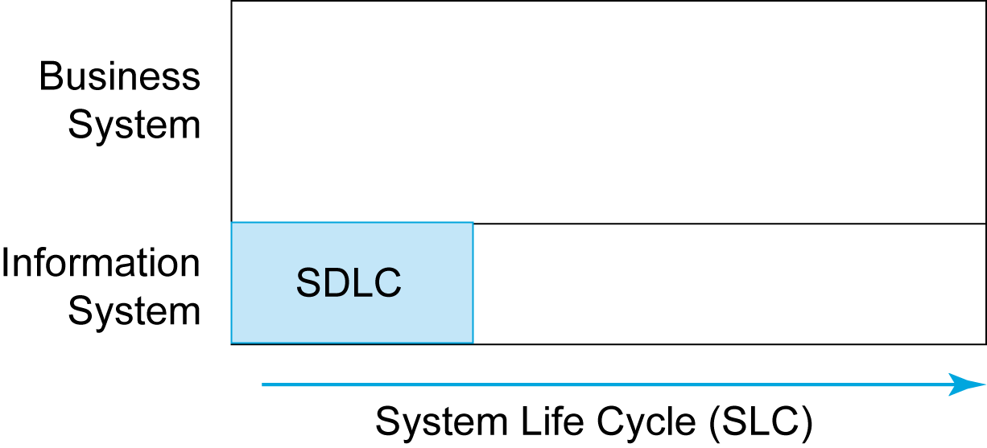
4.1: The SDLC versus the SLC
Networking must go beyond the systems development life cycle to the full system life cycle over the network’s life.
It also needs to understand the business system in which each network component operates.
Notes:
Read the bubble text.
Show the figure.

Slide 6

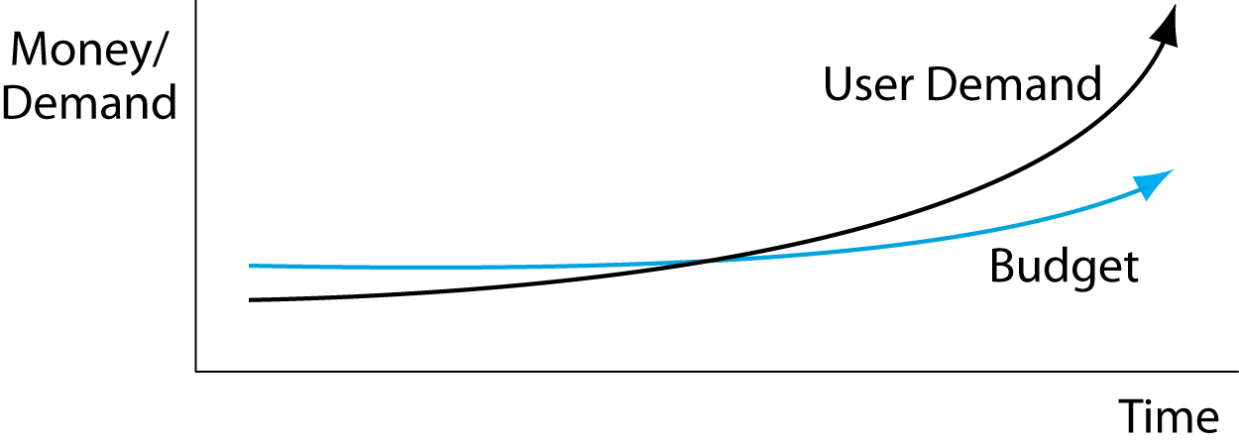
4.2: Network Demand and Budget
User demand is growing much faster than network budgets.
Cost efficiency is always critical.
Notes:
Read the bubble text.
Show the figure.

Slide 7
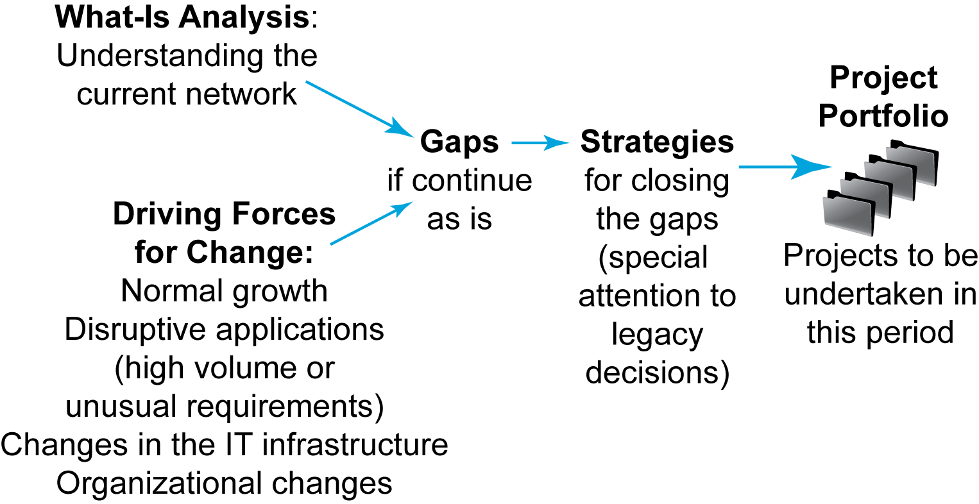
4.3: Strategic Network Planning
Notes:
Go through the figures from left to right.

Slide 8
Network Design and Management Topics
Quality of service (QoS)
Network design
Network visibility (SNMP)

Slide 9
4.4: Network Quality of Service
Networks today must work well.
Companies measure quality-of-service (QoS) metrics to measure network performance.
Examples:
Speed
Availability
Error rates
And so on
Notes:
Read the text.

Slide 10

4.5: Transmission Speed
Prefix | Meaning | Example
kbps* | 1,000 bps | 33 kbps is 33,000 bps
Mbps | 1,000 kbps | 3.4 Mbps is 3,400,000 bps 3.4 Mbps is 3,400 kbps
Gbps | 1,000 Mbps | 62 Gbps = 62,000,000,000 bps = 62,000 Mbps
Tbps | 1,000 Gbps | 5.3 Tbps = 5,300,000,000,000
*Note that the metric prefix kilo is abbreviated with a lowercase k
Notes:
Go through the table from top to bottom.

Slide 11
4.5: Transmission Speed
Expressing speed in proper notation
There must be one to three places before the decimal point, and leading zeros do not count.
As Written | Places before decimal point | Space between number and prefix? | Properly written
23.72 Mbps | 2 | Yes | OK as is
2,300 kbps | 4 | No | 2.3 Mbps
0.5Mbps | 0 | No | 500 kbps
Notes:
Read the text.
Go through the table from top to bottom.

Slide 12
4.5: Transmission Speed
Expressing speed in proper notation
There must be a space before the metric suffix.
5.44 kbps is OK
5.44kbps is incorrect (no space between the number and the metric prefix)
Notes:
Read the text.

Slide 13
4.5 Transmission Speed
Write the following properly:
34,020 Mbps .0054 Gbps 12.62Tbs

Slide 14
4.5: Transmission Speed
Rated Speed
The speed a system should achieve,
According to vendor claims or the standard that defines the technology.
Throughput
The speed a system actually provides to users
(Almost always lower)
Notes:
Read the text.
This is an important concept.

Slide 15
4.5: Transmission Speed
Aggregate Throughput
The aggregate throughput is the total throughput available to all users.
Individual Throughput
An individual’s share of the aggregate throughput
Notes:
Read the text.
This continues the previous example.

Slide 16
4.5: Transmission Speed
Individual throughput
Aggregate throughput
Rated speed

Slide 17
4.6: Quality of Service II
Availability
The time (percentage) a network is available for use
Example: 99.9%
Downtime is the amount of time (minutes, hours, days, etc.) a network is unavailable for use.
Example: An average of 12 minutes per month
Notes:
Read the text.

Slide 18
4.6: Quality of Service II
Error Rates
Errors are bad because they require retransmissions.
More subtly, when an error occurs, TCP assumes that there is congestion and slows its rate of transmission.
Packet error rate: the percentage of packets that have errors.
Bit error rate (BER): the percentage of bits that have errors.
Notes:
Read the text.

Slide 19
4.6: Quality of Service II
Latency
Latency is delay, measured in milliseconds.
When you ping a host’s IP address, you get the latency to the host.
When you use tracert, you get average latency to each router along the route.
Beyond about 250 ms, turn-taking in conversations becomes almost impossible.
Latency hurts interactive gaming.
Notes:
Read the text.

Slide 20
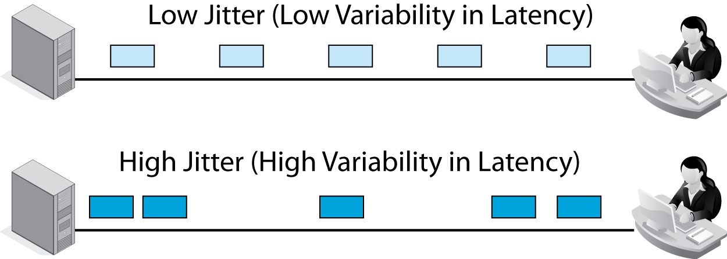
4.6: Quality of Service II
Jitter
Jitter is variation in latency between successive packets. (Figure 4.7)
Makes voice and music speed up and slow down over milliseconds—sounds jittery.
Notes:
Read the text.
Show low and high variability in latency.

Slide 21
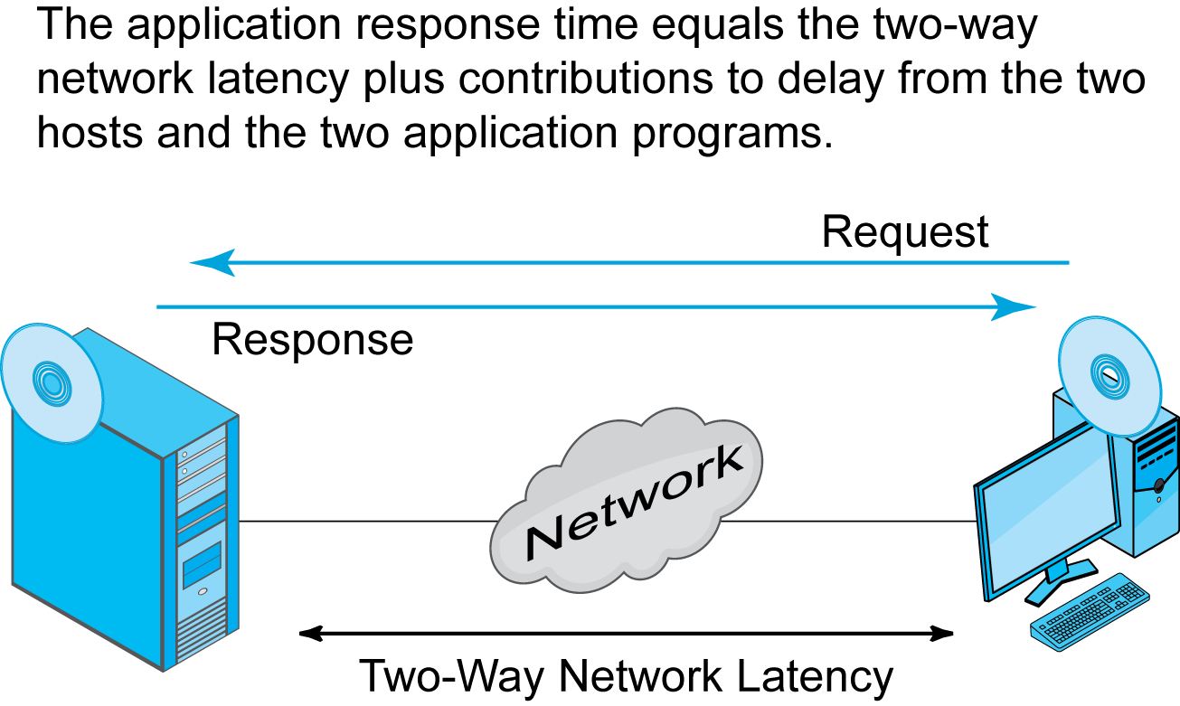
4.6 Quality of Service II
Application Response Time (Figure 4.8)
Notes:
Read the text.
In the figure, show why application response time is longer than network latency.

Slide 22
4.6: Quality of Service II
Service Level Agreements (SLA)
Guarantees for performance
Increasingly demanded by users
Penalties if the network does not meet its QoS metric guarantees
Notes:
Read the text.

Slide 23
4.6: Quality of Service II
Service Level Agreements (SLA)
Guarantees are often written on a percentage of time basis.
“No worse than 100 Mbps 99.95% of the time.”
As percentage of time requirement increases, the cost to provide service increases exponentially.
So SLAs cannot be met 100% of the time.
Notes:
Read the text.

Slide 24
4.6: Quality of Service II
Service Level Agreements (SLA)
SLAs specify worst cases (minimum performance to be tolerated)
Penalties if worse than the specified performance
Example: latency no higher than 50 ms 99.99% of the time
If specified the best case (maximum performance), you would rarely get better
Example: No higher than 100 Mbps 99% of the time. Who would want that?
Notes:
Read the text.

Slide 25
4.6: Quality of Service II
Jitter
No higher than 2% variation in packet arrival time 99% of the time
Latency
No higher than 125 Mbps 99% of the time
Availability
No lower than 99.99%
Availability is a percentage of time, so its SLA does not include a percentage of time
Notes:
Read the text.

Slide 26
Network Design and Management Topics
Quality of service (QoS)
Network design
Network visibility (SNMP)
Notes:
Network design is a critical skill.

Slide 27
Network Drawing Tools
To manage a network, it helps to be able to draw pictures of it.
Network drawing programs do this.
There are many network drawing programs.
One is Microsoft Office Visio.
Must buy the correct version to get network and computer templates
Notes:
Read the text.

Slide 28
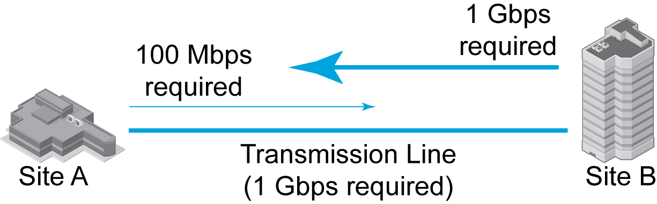
4.9: Two-Site Traffic Analysis
You must be able to compute what traffic a line must carry in each direction to select an appropriate transmission line.
Notes:
Read the text.
Then go through the figure.

Slide 29
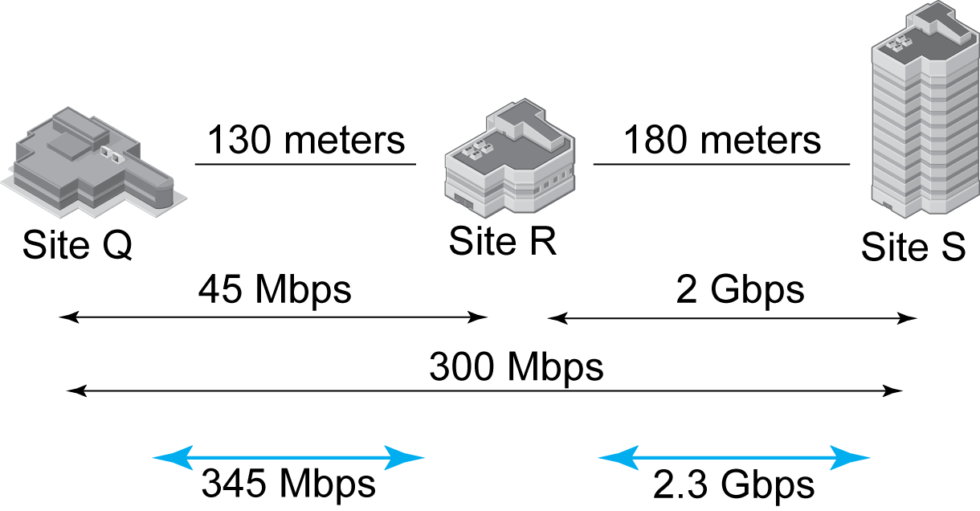
4:10: Three-Site Analysis
Notes:
Go through the figure top to bottom.

Slide 30
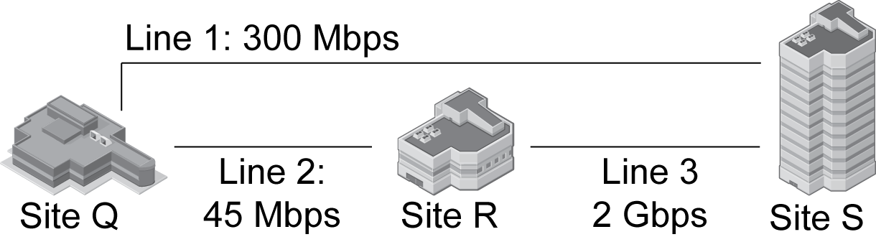
4.11: Three Sites (No Redundancy)
Notes:
Go through the figure.

Slide 31
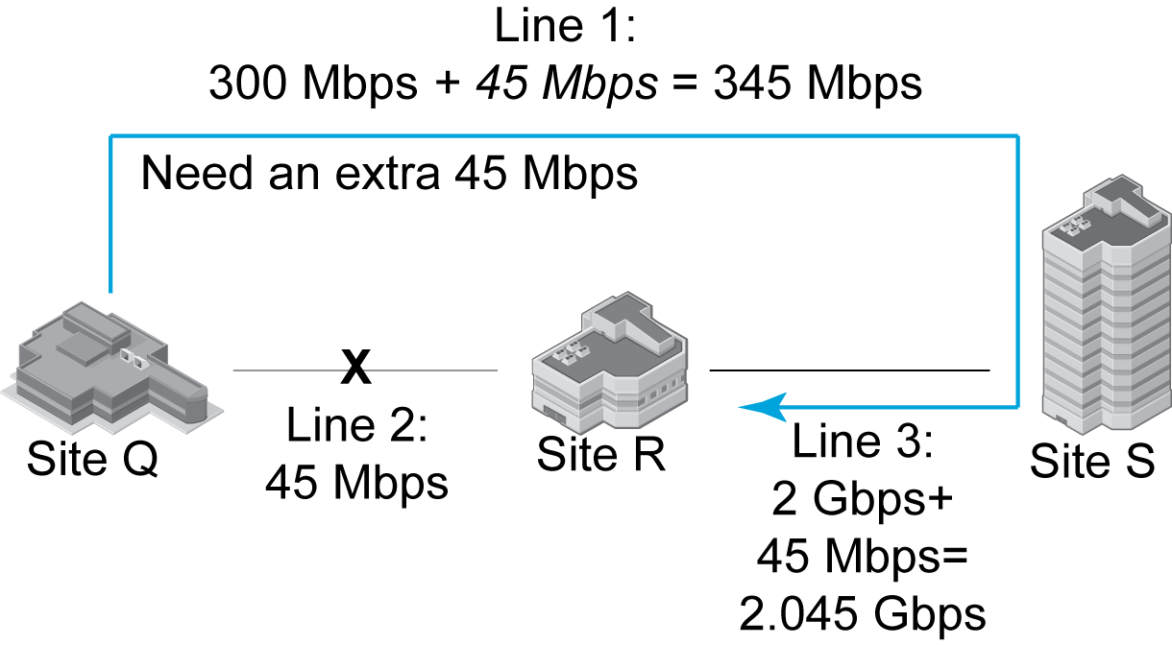
4.11: Three Sites (with Redundancy)
Notes:
Here, Line 2 fails.
Its 45 Mbps must be added to the other links.

Slide 32
4.12: Major Topologies
Topologies describe the physical arrangement of nodes and links.
“Topology” is a physical layer concept.
Many standards require specific topologies.
In other cases, you can select topologies that make sense in terms of transmission costs, reliability through redundancy, and so on.
Notes:
Read the text.

Slide 33
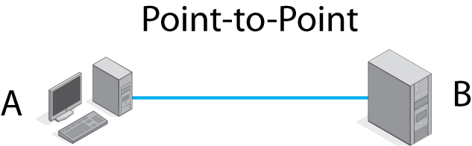
4.12: Major Topologies
How many possible paths are
there between A and B?
Notes:
One. Duh.

Slide 34
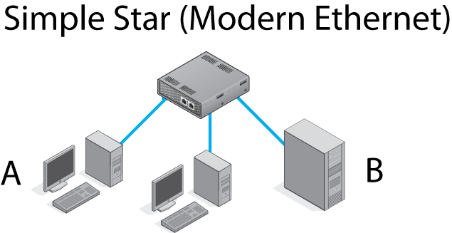
4.12: Major Topologies
How many possible paths are
there between A and B?
Notes:
One. A-switch-B.

Slide 35
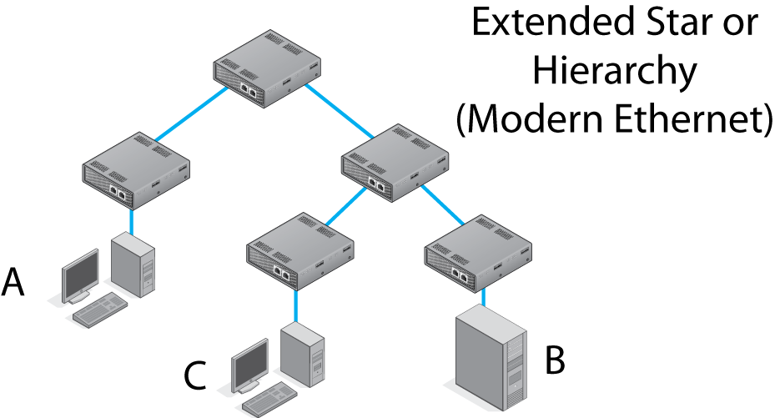
4.12: Major Topologies
In a hierarchy, each node has one parent.
How many possible paths are there between A and B?
Notes:
Read the first bubble.
For the second bubble, the answer is one.
(In a hierarchy, there is always one possible path. Try A to C and C to B.)

Slide 36
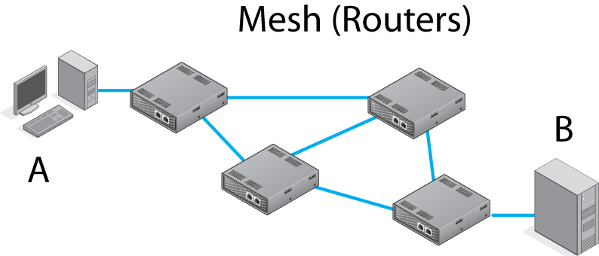
4.12: Major Topologies
3
1
2
4
How many possible paths are there between A and B?
Notes:
Have students list a few.
Several. (The exact number is unimportant)
In a mesh, there always are multiple alternative routes.

Slide 37
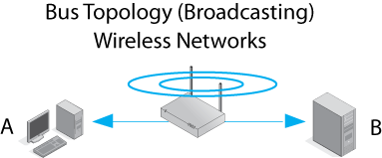
4.12: Major Topologies
What do you think will happen if A and B transmit at the same time?
Notes:
If they transmit in the same channel, their signals will interfere with each other.
(We will see this in Chapter 7, which discusses how wireless networking works.)

Slide 38
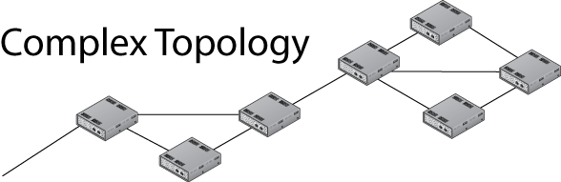
4.12: Major Topologies
Many real networks have complex topologies incorporating the pure topologies we have just seen.
Notes:
Read the text.

Slide 39
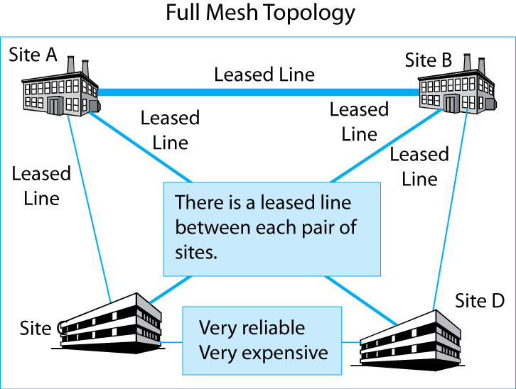
4.13: Full Mesh vs Hub-and-Spoke
Notes:
Read the two boxes and show what each means on the figure.

Slide 40
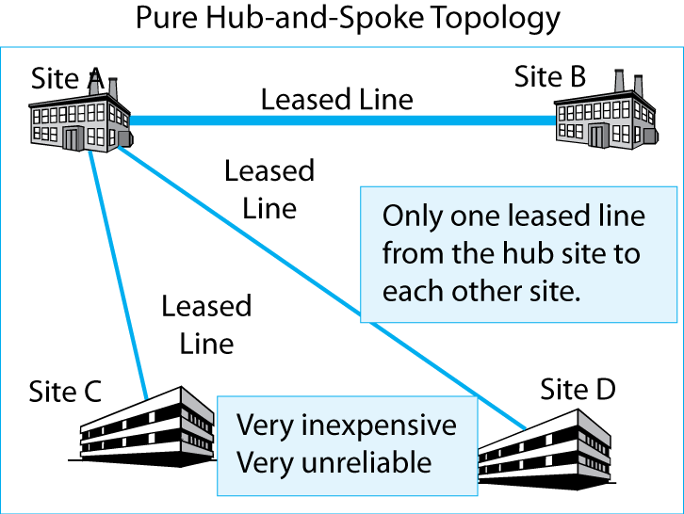
4.13: Full Mesh vs Hub-and-Spoke
Notes:
Read the two boxes and show what each means on the figure.

Slide 41
4.13: Full Mesh vs Hub-and-Spoke
Full-mesh and hub-and-spoke topologies are opposite ends of a spectrum.
Real network designers must balance cost and reliability when designing complex networks.
Notes:
Read the text.

Slide 42
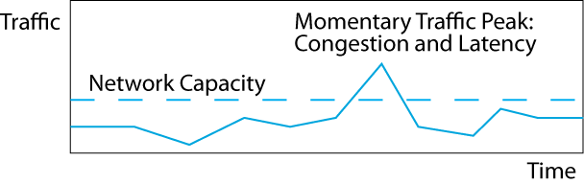
4.14: Momentary Traffic Peaks
Normally, network capacity is higher than the traffic.
Sometimes, however, there will be momentary traffic peaks above the network’s capacity—usually for a fraction of a second to a few seconds.
Notes:
Read the text.
Then illustrate it in the figure.

Slide 43
4.14: Momentary Traffic Peaks
This congestion causes latency because switches and routers must store frames and packets while waiting to send them out again.
Buffers are small, so packets are often lost.
Notes:
Read the text.

Slide 44
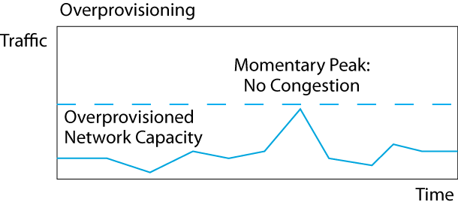
4.14: Momentary Traffic Peaks
Overprovisioning is providing far more capacity than the network normally needs.
This avoids nearly all momentary traffic peaks but is wasteful.
Notes:
Read the text.
Then show this in the figure.

Slide 45
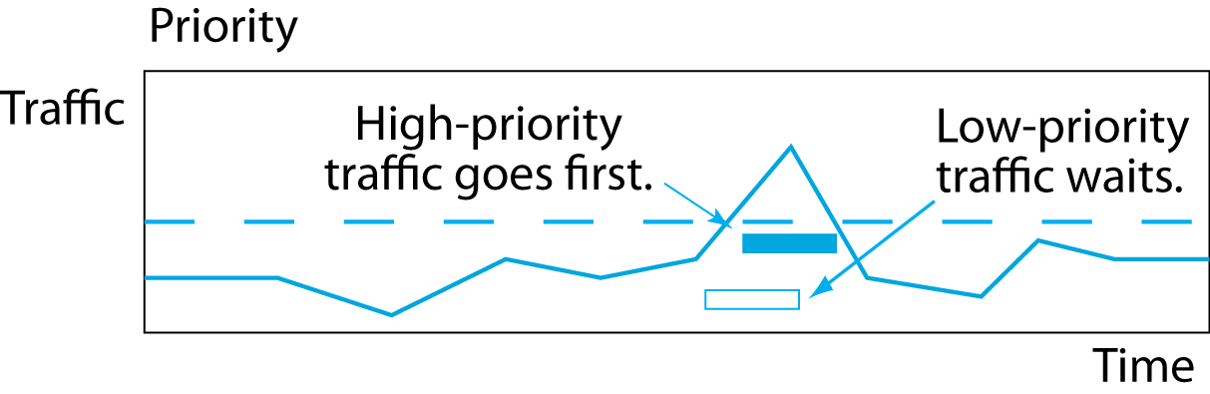
4.14: Momentary Traffic Peaks
With priority, latency-intolerant traffic, such as voice, is given high priority and will go first if there is congestion.
Latency-tolerant traffic, such as e-mail, must wait.
More efficient than overprovisioning; also more labor-intensive.
Notes:
Read the text.
Then show this in the figure.

Slide 46
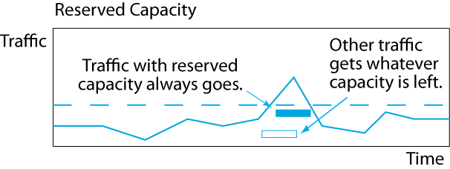
4.14: Momentary Traffic Peaks
QoS guarantees reserved capacity for some traffic, so this traffic always gets through.
Other traffic, however, must fight for the remaining capacity.
Notes:
Read the text.
Then show this in the figure.

Slide 47
4.15: Traffic Shaping
Overprovisioning, priority, and QoS reservations deal with congestion.
Traffic shaping prevents congestion by limiting incoming traffic.
Notes:
Read the text.
Note that the transmission line does not become overloaded.
This is very different than the other methods, which merely manage overload when it occurs.

Slide 48
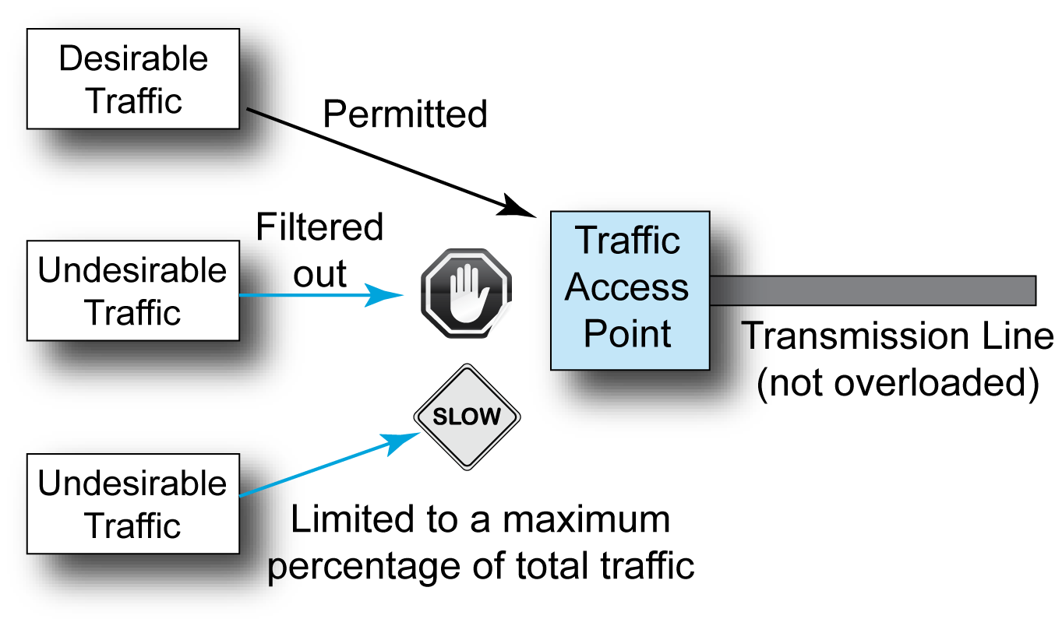
4.15: Traffic Shaping
Notes:
Read the text.
Note that the transmission line does not become overloaded.
This is very different than the other methods, which merely manage overload when it occurs.

Slide 49
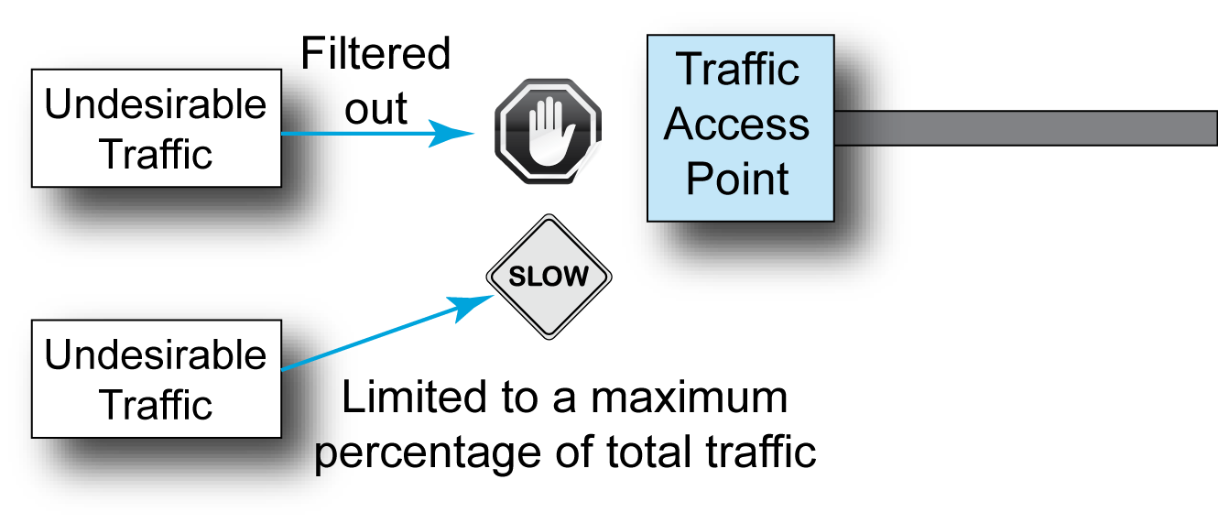
4.15: Traffic Shaping
Some traffic can be banned and simply filtered out.
Other traffic has both legitimate and illegitimate uses; it can be limited to a certain percentage of traffic.
Notes:
Read the text.
Show this in the figure.

Slide 50
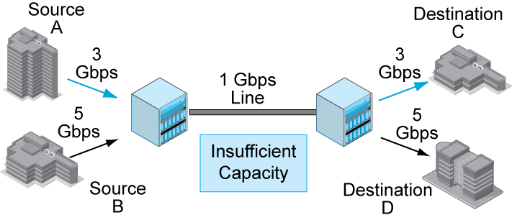
4.16: Compression
Compression can help if traffic chronically exceeds the capacity on a line.
8 Gbps is needed.
The line can carry only 1 Gbps.
Notes:
Describe the figure from left to right.

Slide 51
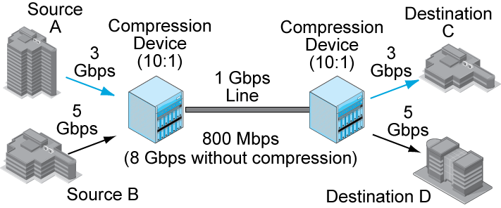
4.16: Compression
Data often contains redundancies and can be compressed.
Notes:
Show how compression changes things.
(Different types of data can be compressed to different degrees.)
(Text has relatively low compressibility.)
(Graphics and video can be highly compressed.)

Slide 52
4.16: Compression
Must have compatible compression equipment at the two ends of the line.
Notes:
Note the decompression.

Slide 53
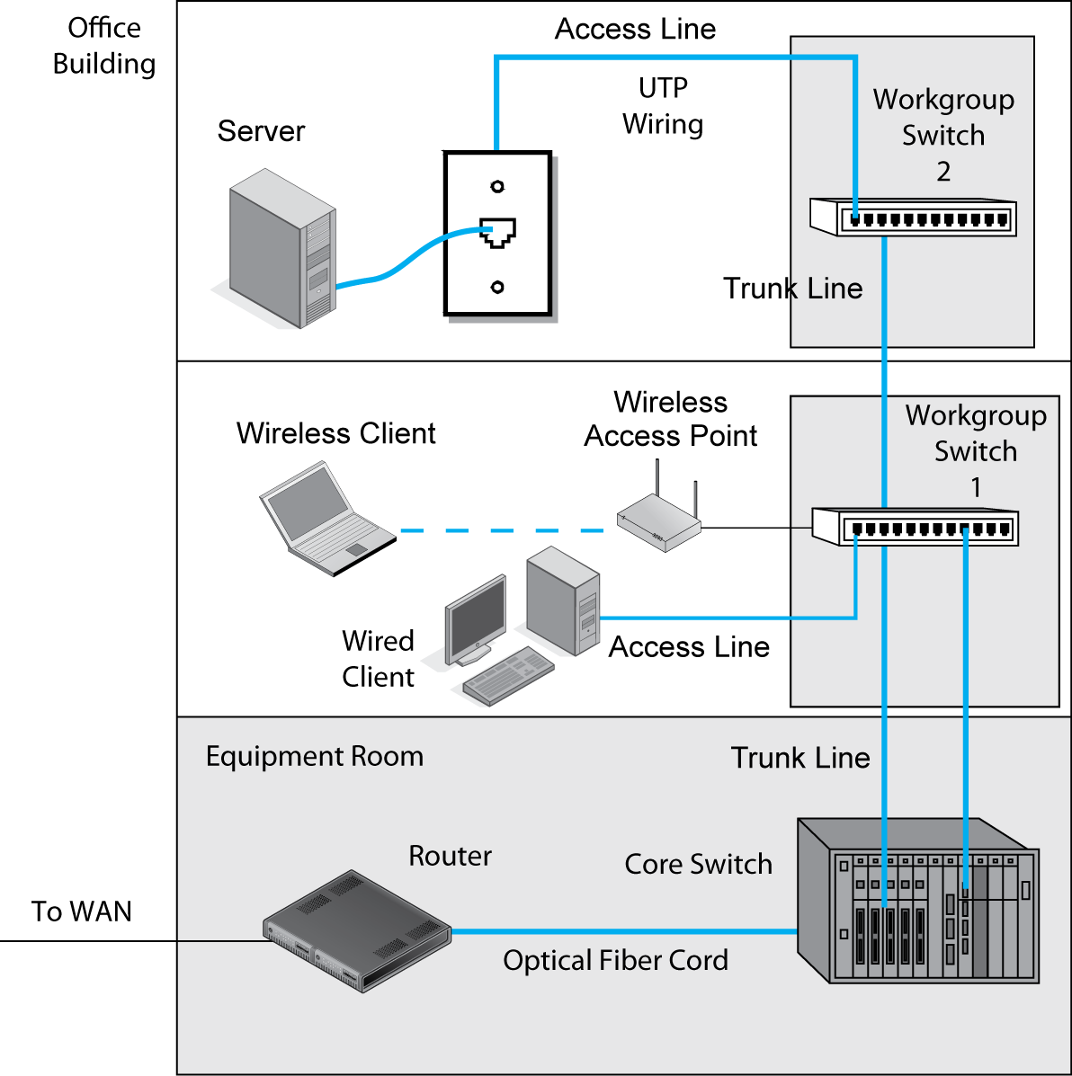
4.17: Natural Designs
Often, the design of a building naturally constrains the topology of a design.
Notes:
Emphasize that reality often determines design.
Note the core and workgroup dimension.

Slide 54
Network Design and Management Topics
Core concerns
Quality of service (QoS)
Network design
Selection among alternatives
Ongoing management (OAM&P)
Network visibility (SNMP)
Notes:
Often, you must select among several design approaches, products, or other matters.
We will see how to do it.

Slide 55
4.18: Product Selection
Comparing Alternatives
Designers must select among competing approaches and even competing technologies.
When learning about technologies and network designs, you need to look carefully at pros and cons.
Comparing alternatives is a major theme of this book.
Do not study concepts in isolation.
Notes:
Read the text.

Slide 56
4.18: Product Selection
Minimum Requirements
Specifications that set particular requirements must be met.
Noncompliant products that do not meet a minimum requirement cannot be considered further.
A failure to scale to meet expected traffic would be an example.
Notes:
Read the text.

Slide 57
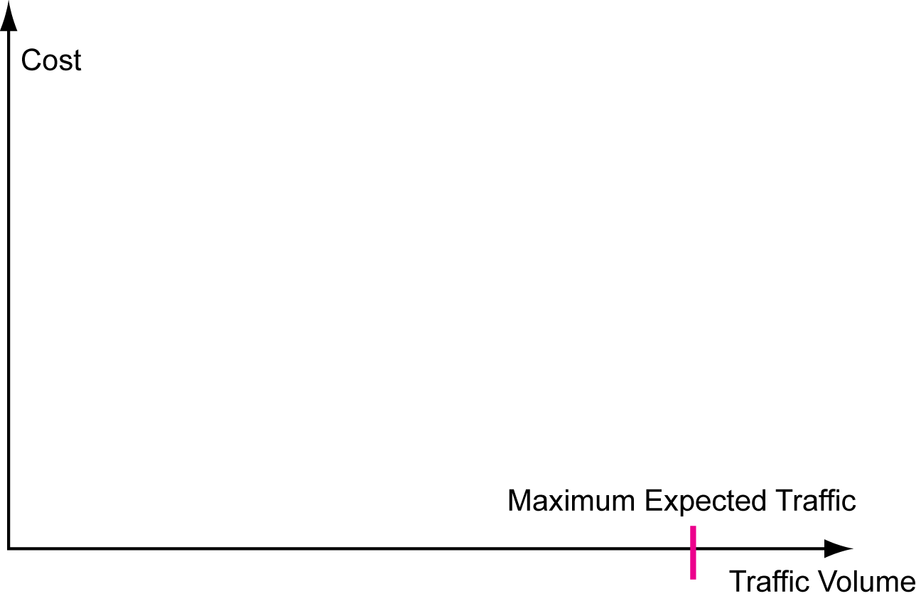
4.18: Product Selection
4.19: Scalability
There is a maximum
expected traffic volume.
Notes:
Scalability is a very important concept in selecting among alternatives.
There is a relationship between cost and expected traffic volume.
There is a maximum expected traffic volume.

Slide 58
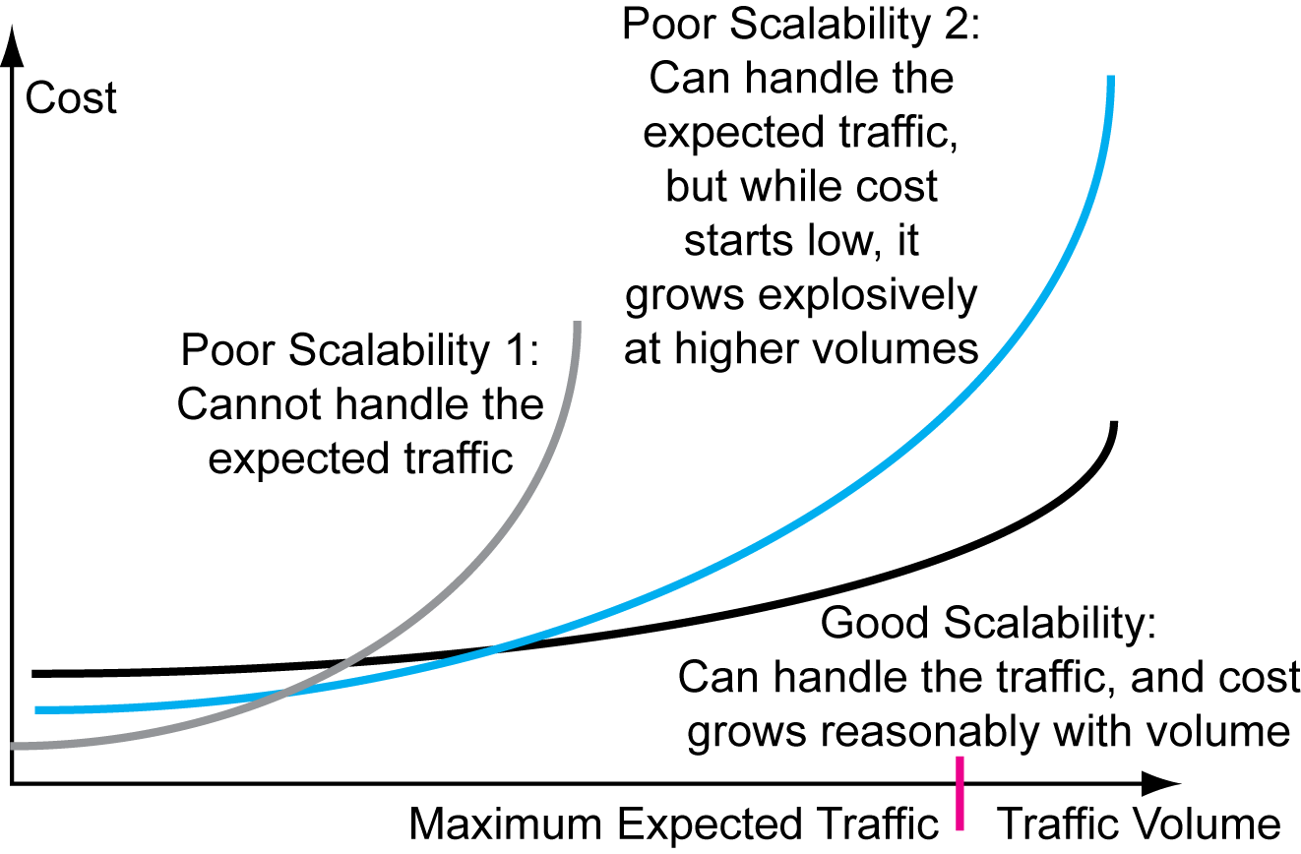
4.18: Product Selection
4.19: Scalability
Notes:
Go through Poor Scalability 1,
Poor Scalability 2, and
Good Scalability

Slide 59
4.20: Product Selection
Multicriteria decision making is a disciplined way to look at and evaluate all aspects of alternatives.
 |  | Product A |  | Product B
Criterion | Criterion Weight (Max 5) | Product Rating (Max 10) | Criterion Score | Product Rating (Max 10) | Criterion Score
Functionality | 5 | 8 | 40 | 4 | 20
Ease of management | 2 | 8 | 16 | 8 | 16
Cost* | 4 | 2 | 8 | 8 | 32
Total Score |  |  | 64 |  | 68
*Higher cost ratings indicate lower cost.
Notes:
Go through the figure.

Slide 60
4.21: Cost
Cost is difficult to measure.
Systems Development Life Cycle Costs
Hardware: full price—base price plus necessary optional components
Software: full price—base price plus necessary optional modules
Labor costs: Network staff and user costs during development
Outsourced development cost
Total development investment
Notes:
Read the text.

Slide 61
4.21: Cost
System Life Cycle Costs
Development cost plus ongoing cost, which usually is much larger than development cost
Measured as the total cost of ownership (TCO)
All costs over a system’s total life
SDLC cost plus carrier costs
Carrier pricing is complex and difficult to analyze
Often locked in by multi-year leases
Notes:
Read the text.

Slide 62
Network Design and Management Topics
Core concerns
Quality of service (QoS)
Network design
Selection among alternatives
Ongoing management (OAM&P)
Network visibility (SNMP)
Notes:
After the systems development life cycle, the real work of networking begins.

Slide 63
4.22: Ongoing Management
Described as OAM&P
Operations
Moment-by-moment traffic management
Network operations center (NOC)
Administration
Paying bills, administering contracts, and so on
Dull but necessary
Notes:
Read the text.

Slide 64
4.22: Ongoing Management
Maintenance
Fixing things that go wrong
Also, preventative maintenance
Maintenance staff should be separate from the operations staff
Different skill set
Notes:
Read the text.

Slide 65
4.22: Ongoing Management
Provisioning (providing service)
Includes physical installation
Includes setting up user accounts and services
Reprovisioning when things change
Deprovisioning when accounts and services are no longer appropriate
Collectively, extremely expensive
Notes:
Read the text.

Slide 66
Network Design and Management Topics
Quality of service (QoS)
Network design
Network visibility (SNMP)
Notes:
You can’t manage what you don’t understand.
Network visibility is a term that refers to the effects of tools to reveal what the network is doing to network administrators.

Slide 67
4.26: Simple Network Management Protocol (SNMP)
It is desirable to have network visibility—to know the status of all devices at all times.
Ping can determine if a host or router is reachable.
The simple network management protocol (SNMP) is designed to collect extensive information needed for network visibility.
Notes:
Read the text.

Slide 68
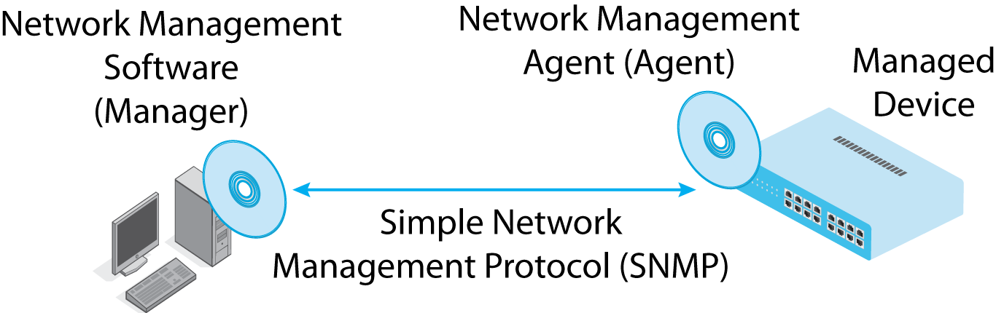
4.23: SNMP
Central manager program communicates with each managed device.
Actually, the manager communicates with a network management agent on each device.
Notes:
Read the text.
(The idea that the manager communicates with the agent, not the managed device, is tricky. Explain that sports stars have agents that negotiate with the owner on the behalf of the stars.)

Slide 69
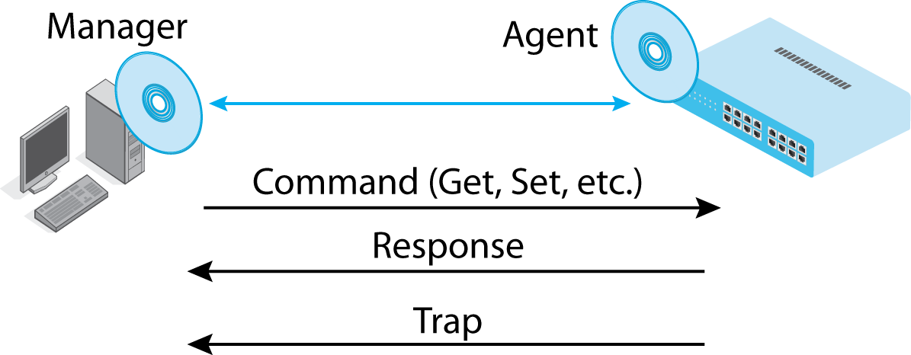
4.23: SNMP
The manager sends commands and gets responses.
Agents can send traps (alarms) if there are problems.
Notes:
Note the three types of messages and which entity sends them—the manager or the agent.

Slide 70
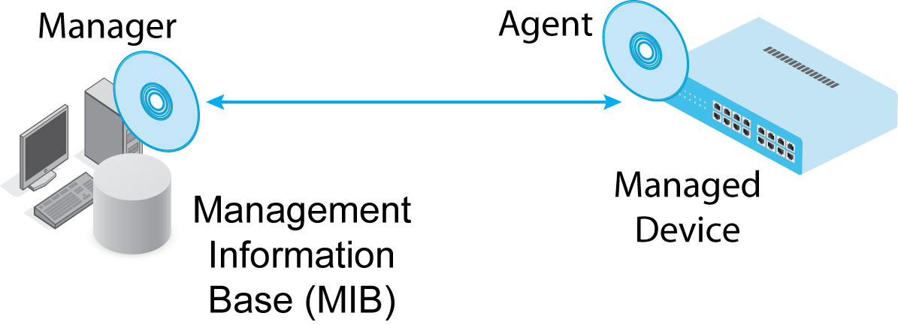
4.23: SNMP
Information from agents is stored in the SNMP management information base.
Notes:
The MIB is an organized way to store information from all managed devices.
(It is an object-oriented database, if students know what that is.)

Slide 71
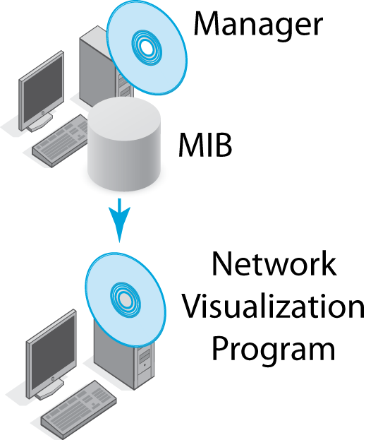
4.23: SNMP
Network visualization programs analyze information from the MIB to portray the network, do troubleshooting, and answer specific questions.
Notes:
Note the difference between the manager and the network visualization programs.
Read the text on the right.

Slide 72
4.23: SNMP
SNMP interactions are standardized, but network visualization program functionality is not, in order not to constrain developers of visualization tools.
Notes:
Note the difference between the manager and the network visualization programs.
Read the text on the right.

Slide 73
Where We’ve Been
Quality of service (QoS)
Network design
Network visibility (SNMP)

Slide 74
Where We are Going Next
We have finished the four introductory chapters.
How we got here
Network standards
Network security
Network design and management
We will apply the concepts you learned in these chapters throughout the book.

Slide 75
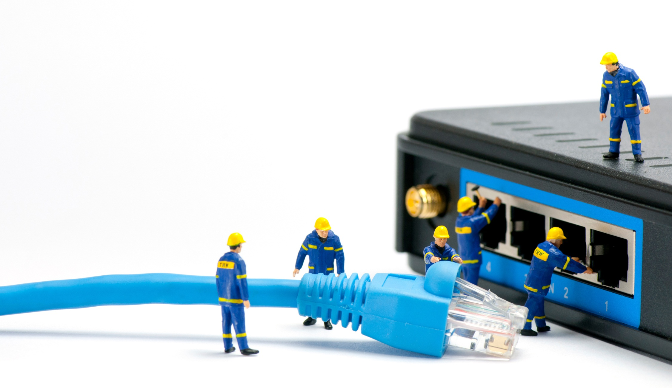

Wired Ethernet LANs
Chapter 5
Chapter 5

Slide 76
Ethernet
Ethernet Basics
Physical Layer Ethernet Standards
Data Link Layer Ethernet Standards
Ethernet Security

Slide 77
Where We’ve Been
Four Introductory Chapters
Gave you the concepts and principles to apply for the rest of the term
Chapter 1: Core concepts
Chapter 2: Standards concepts
Chapter 3: Security principles
Chapter 4: Network management

Slide 78
Where We Are Going
Three Chapters on Local Area Networks
Chapter 5: Wired Ethernet LANs
Chapters 6 and 7: Wireless LANs
Governed by Layer 1 and Layer 2 Standards
Remaining Chapters
Chapters 8 and 9: TCP/IP Internetworking
Chapter 10: Wide Area Networks
Chapter 11: Applications

Slide 79
5.1: LANs versus WANs
Characteristic | Local Area Network (LAN) | Wide Area Network (WAN)
Location | Located entirely on customer’s premises | Must carry transmissions beyond customer’s premises
Consequence of Location | Owning company operates the LAN | User must contract with a carrier that has rights of way to carry wires between premises

Slide 80
5.1: LANs versus WANs
Characteristic | Local Area Network (LAN) | Wide Area Network (WAN)
Technology and Service Consequence of Corporate versus Carrier Ownership | Owner can use any technology and service options it wishes | Customer is limited to technologies and service options offered by available carriers

Slide 81
5.1: LANs versus WANs
Characteristic | Local Area Network (LAN) | Wide Area Network (WAN)
Labor Consequences of Corporate versus Carrier Ownership | Owner must do all operation and maintenance work | Operational and maintenance work is done by the carrier

Slide 82
5.1: LANs versus WANs
Characteristic | Local Area Network (LAN) | Wide Area Network (WAN)
Economics | Transmission distances are short, so the cost per bit carried is low | Transmission distances are long, so the cost per bit carried is high

Slide 83
5.1: LANs versus WANs
Characteristic | Local Area Network (LAN) | Wide Area Network (WAN)
Speed Consequences of Economics | Very high speeds are affordable | Customers are content with lower speeds
Design Consequences of Economics | Optimization of transmission capacity is not pressing | Optimization of transmission capacity is critical

Slide 84
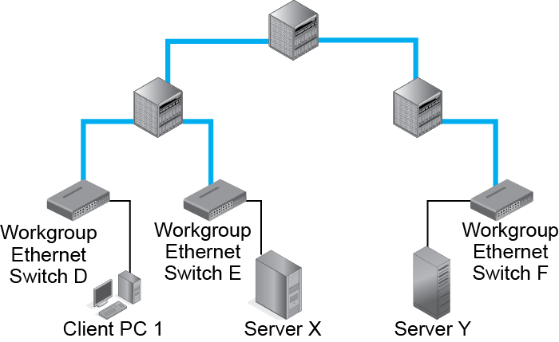
5.2: Workgroup and Core Switches
Workgroup Switches Connect Hosts to the Network

Slide 85
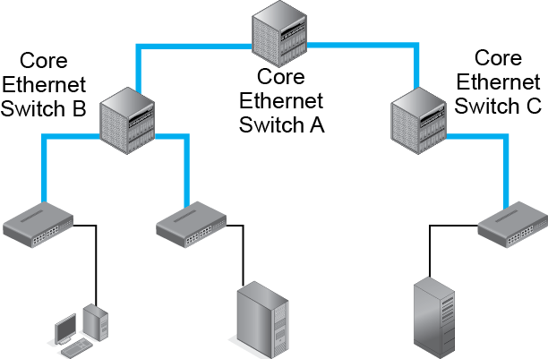
5.2: Workgroup and Core Switches
Core Switches Connect Switches to Other Switches

Slide 86
5.2: Workgroup and Core Switches
Hosts Normally Connect to Workgroup Switches Through UTP Copper Wiring

Slide 87
5.2: Workgroup and Core Switches
Switches Often Connect to Other Switches Through Optical Fiber

Slide 88
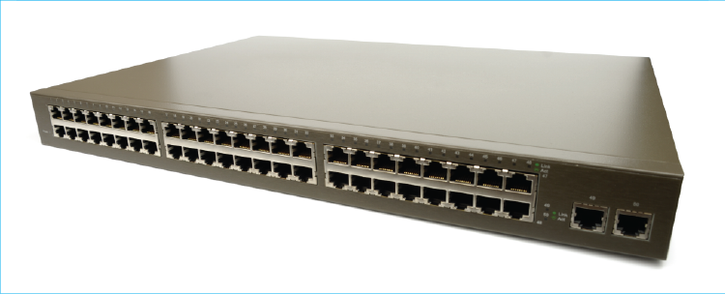
5.3 Ethernet Workgroup Switch

Slide 89
5.4: UTP and Optical Fiber
Characteristic | Unshielded Twisted Pair | Optical Fiber
Medium | Copper wire | Glass
Signal | Electrical | Light
Maximum Distance in LANs | Usually 100 meters | Usually 200 to 500 meters
Speed | Similar | Similar
Cost | Lower | Higher

Slide 90
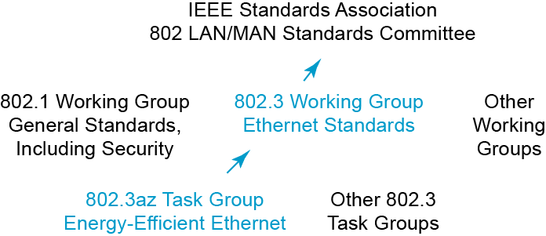
5.5: Ethernet Standards Development
Notes:
802.3 is the ethernet standard.

Slide 91
Ethernet
Ethernet Basics
Physical Layer Ethernet Standards
Data Link Layer Ethernet Standards
Ethernet Security

Slide 92
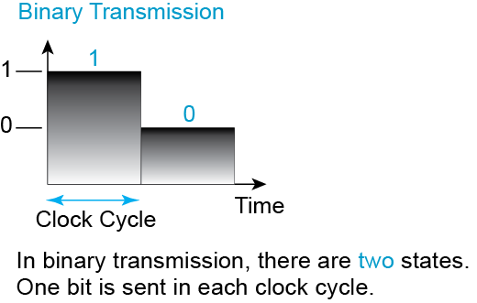
5.6: Binary and Digital

Slide 93
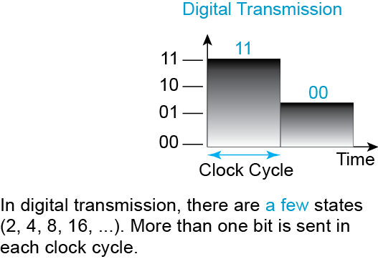
5.6: Binary and Digital

Slide 94
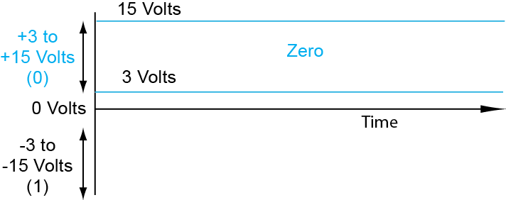
5.7: Binary Resistance to Error

Slide 95
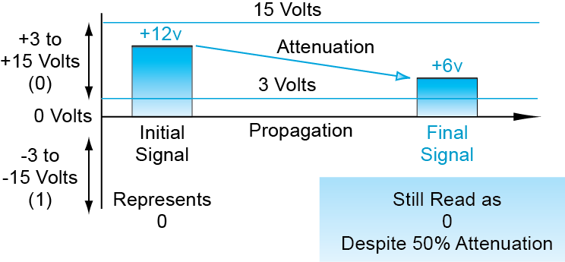
5.7: Binary Resistance to Error

Slide 96
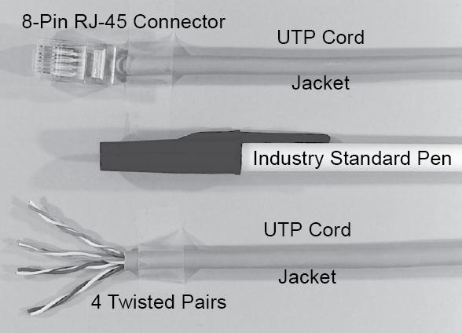
5.8: UTP Cord

Slide 97
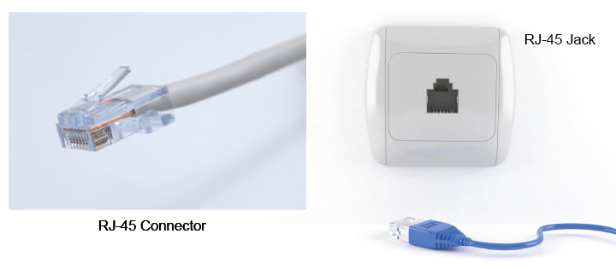
5.9: RJ-45 Connector and Jack

Slide 98
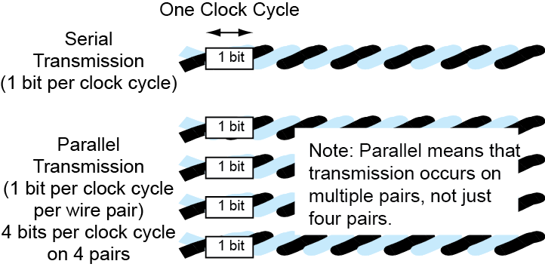
5.10: Serial versus Parallel Transmission
NOT just 4 pairs!

Slide 99
5.11: Propagation Effects
Propagation Effect(s) | Impact | Installation Discipline
Attenuation | Signal may become too low to be received properly. | Limit cord distance to 100 m
Noise | Random electromagnet energy in the wire (noise) adds to the signal and may produce errors.
Terminal crosstalk interference | Interference by other wire pairs in the cord is crosstalk interference. Crosstalk interference at the two ends where the wires are untwisted is terminal crosstalk interference. Major problem | Limit untwisting of the wires to 1.25 cm (0.5 in)

Slide 100
5.12: Internet Signaling Standards and UTP Quality Levels
Ethernet Signaling Standard | Transmission Speed | UTP Quality Category | Maximum Cord Length
100BASE-TX | 100 Mbps | Category 5e, 6, or higher | 100 meters
1000BASE-T | 1 Gbps | Category 5e, 6, or higher | 100 meters
10GBASE-T | 10 Gbps | Category 6 | 55 meters
10GBASE-T | 10 Gbps | Category 6A | 100 meters
Category is a measure of UTP QUALITY

Slide 101
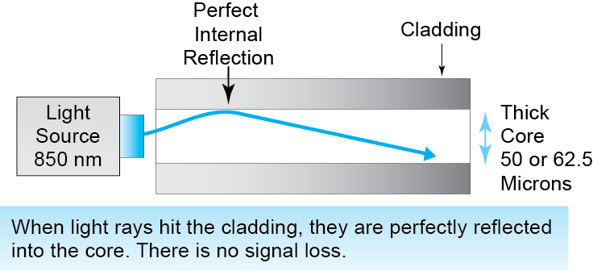
5.13: Optical Fiber Transmission

Slide 102
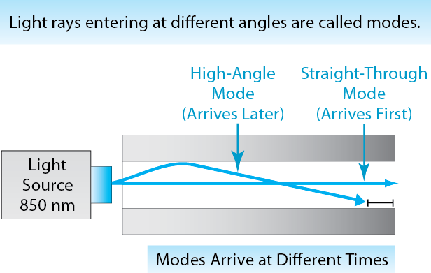
5.13: Optical Fiber Transmission

Slide 103
5.13: Optical Fiber Transmission
When modes arrive at different times, this is called modal dispersion.
If light rays from different clock cycles overlap, modal dispersion may make the signal unreadable.

Slide 104
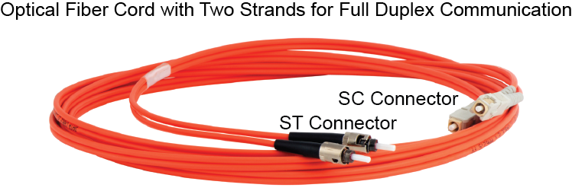
5.14: Optical Fiber Cord and Connections

Slide 105
5.15: Modal Bandwidth
Wavelength | Core Diameter | Modal Bandwidth | Maximum Propagation Distance
850 nm | 62.5 microns | 160 MHz-km | 220 m
850 nm | 62.5 microns | 200 MHz-km | 270 m
850 nm | 50 microns | 500 MHz-km | 500 m

Slide 106
Medium Quality
UTP
Optical Fiber
UTP wire quality is indicated by a cord’s category number (5e, 6, etc.).
Multimode optical fiber quality is indicated by a cord’s modal bandwidth.

Slide 107
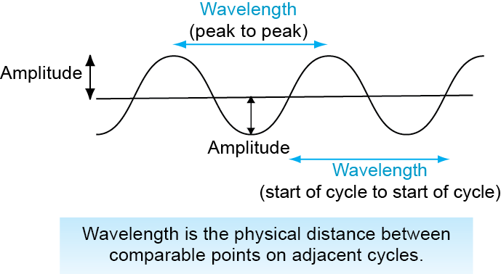
5.16: Wavelength

Slide 108
5.16: Wavelength
Wavelength is the physical distance between comparable points on adjacent cycles.
Optical fiber transmission is described in terms of wavelength.
Wavelengths for optical fiber are measured in nanometers (nm).
For LANs, 850 nm light is used almost exclusively.

Slide 109
5.17: LAN versus Carrier Fiber
Characteristic | LAN Fiber | Carrier WAN Fiber
Required Distance Span | 200 to 300 m | 1 to 40 m
Light Wavelength | 850 nm | 1,310 or 1,550 nm
Type of Fiber | Multimode (Thick Core) | Single-Mode (Thin Core)
Core Diameter | 50 or 62.5 microns | 8.3 microns

Slide 110
5.17: LAN versus Carrier Fiber
Characteristic | LAN Fiber | Carrier WAN Fiber
Primary Distance Limitation | Modal Dispersion | Absorptive Attenuation
Quality Metric | Modal Bandwidth (MHz-km) | Not Applicable

Slide 111
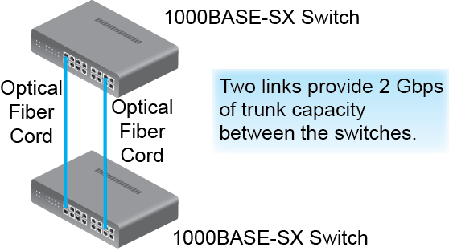
5.18: Link Aggregation

Slide 112
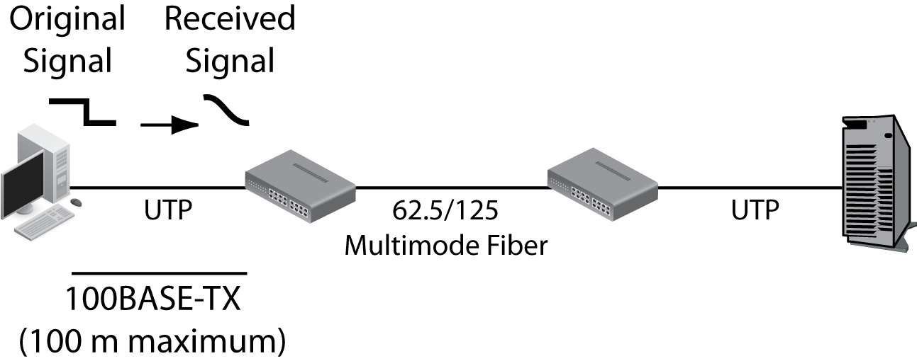
5.19: Data Link Using Multiple Switches
The first physical link is 100BASE-TX,
so the maximum physical span is 100 meters.
Notes:
Read the bubble text.
Show it in the figure.

Slide 113

5.19: Data Link Using Multiple Switches
The switch regenerates the received signal.
On a 1000BASE-SX link, the clean new signal
can travel up to another 220 meters.
Notes:
Read the bubble text.
Show it in the figure.

Slide 114

5.19: Data Link Using Multiple Switches
The second switch also regenerates the signal.
The clean regenerated signal goes on.

Slide 115

5.19: Regeneration

Slide 116
Ethernet
Ethernet Basics
Physical Layer Ethernet Standards
Data Link Layer Ethernet Standards
Ethernet Security

Slide 117

5.22: Multiswitch Ethernet LAN
A packet from A1… to E5… must pass through Switches 1, 2, and 3.
Notes:
Read the bubble text.
Show it in the figure.

Slide 118

5.22: Multiswitch Ethernet LAN
Switch 1 sees that it should send the frame to E5 out Port 5.
Notes:
Read the bubble text.
Show it in the figure.

Slide 119

5.22: Multiswitch Ethernet LAN
Switch 2 sees that it should send the frame to E5 out Port 7.
Notes:
Read the bubble text.
Show it in the figure.

Slide 120

5.22: Multiswitch Ethernet LAN
Switch 3 sees that it should send the frame to E5 out Port 6.
Notes:
Read the bubble text.
Show it in the figure.

Slide 121

5-23: Hierarchical LAN

Slide 122

5.24: Single Points of Failure

Slide 123

5.25: Rapid Spanning Tree Protocol
Loops are not allowed in Ethernet.
A strict hierarchy is required.

Slide 124

5.26: Rapid Spanning Tree Protocol

Slide 125

5.27: Virtual LANs (VLANs)

Slide 126
5.28: Priority and Overprovisioning
Tag Control Information (TCI) Field
There are 12 bits for VLAN addresses.
There are 3 bits for frame priority.
This permits 2³ = 8 different priority values.

Slide 127

5.29: Managed Switches

Slide 128
Ethernet
Ethernet Basics
Physical Layer Ethernet Standards
Data Link Layer Ethernet Standards
Ethernet Security

Slide 129
5.31: Ethernet 802.1X Security
The Problem
Anyone can enter the building and plug their computer into a switch or into a wall RJ-45 port, which connects to a switch.
This usually gives the attacker access to the network without going through a firewall.
Solution: access control at switch ports.
802.1X Port Based Access Control can do this.
Created by the 802.1 WG, not the 802.3 WG.
802.1 WG creates general standards, such as security standards.

Slide 130

5.31: Ethernet 802.1X Security

Slide 131

5.31: Ethernet 802.1X Security

Slide 132
5.21: Ethernet 802.1X Security
Advantages of a Central Authentication Server
Consistency: Attacker cannot find a misconfigured switch.
Rapid changes: When someone leaves, is hired, or needs credential changes.
Switch cost: Authentication server does heavy work.
Reduced management cost: Only one authentication database to maintain.

Slide 133
802.3ba
Box
802.3ba governs Ethernet for both 40 Gbps and 100 Gbps
Virtual Lane
Entire 40 Gbps or 100 Gbps
Media Lane
Physical connection
There may be several per virtual lane
Essentially, built-in bonding

Slide 134
802.3ba
Box
Example: 100GBASE-SR10
100 Gbps virtual lane
S = 850 nm light
R = How bits are processed
10 = 10 Gbps media lane
Media Lanes
10 Mbps optical fiber pairs
2 extra pairs
24 optical fiber strands in total

